Slide 1


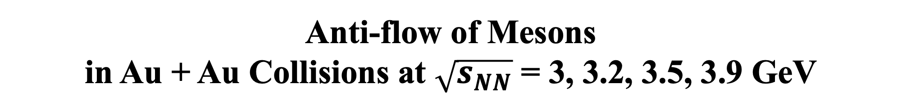
Anti-flow of Mesons
in Au + Au Collisions at $\sqrt{s_{NN}}$ = 3, 3.2, 3.5, 3.9 GeV
Zuowen Liu
Central China Normal University

Slide 2
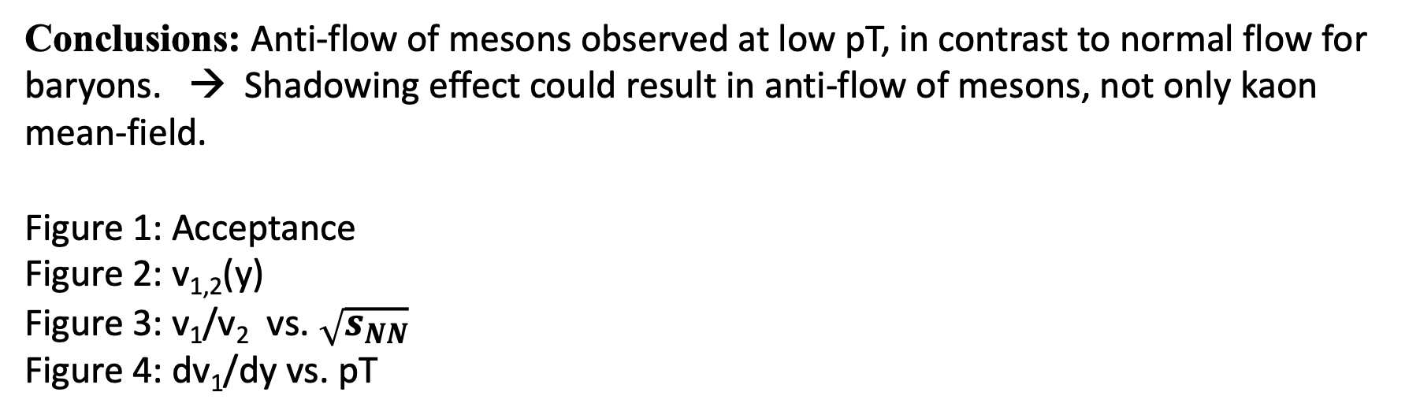
Paper proposal
Short paper: v1/v2 of pi+/pi-, K0s, lambda @ 3 - 3.9 GeV
Conclusions: Anti-flow of mesons observed at low pT, in contrast to normal flow for baryons. → Shadowing effect could result in anti-flow of mesons, not only kaon mean-field.
Figure 1: Acceptance
Figure 2: v_{1,2}(y)
Figure 3: v₁/v₂ vs. $\sqrt{s_{NN}}$
Figure 4: dv₁/dy vs. pT

Slide 3
Fig. 1 (Acceptance )
Pion在low pt加上tof
X轴调到 y<0.3
Pi/K/lambda 字体变大
3.0 GeV放最上面一行最中间
右边彩色的label
Rapidity cut:
-1 < y < 0
pT cut:
𝜋+/K0s: 0.2 < pT < 1.6
𝛬: 0.4 < pT < 2

Slide 4
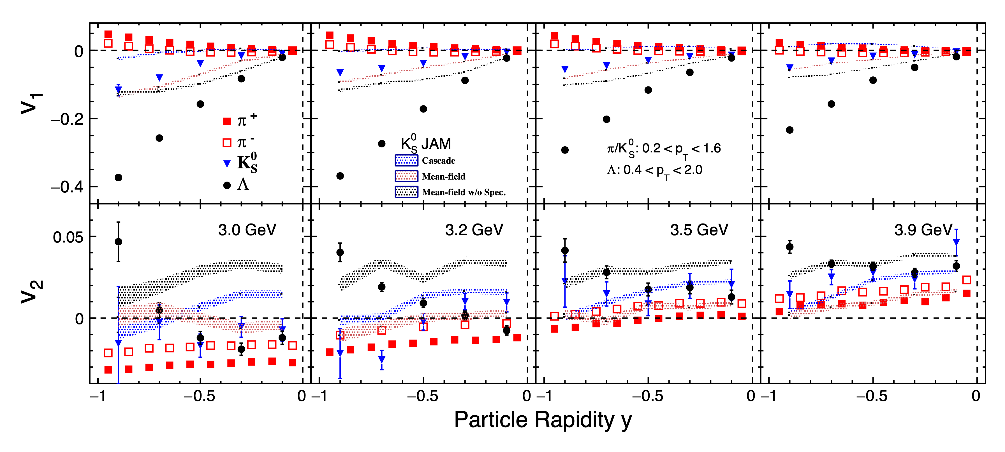
Fig. 2 (v₁/v₂ vs. y)

Slide 5
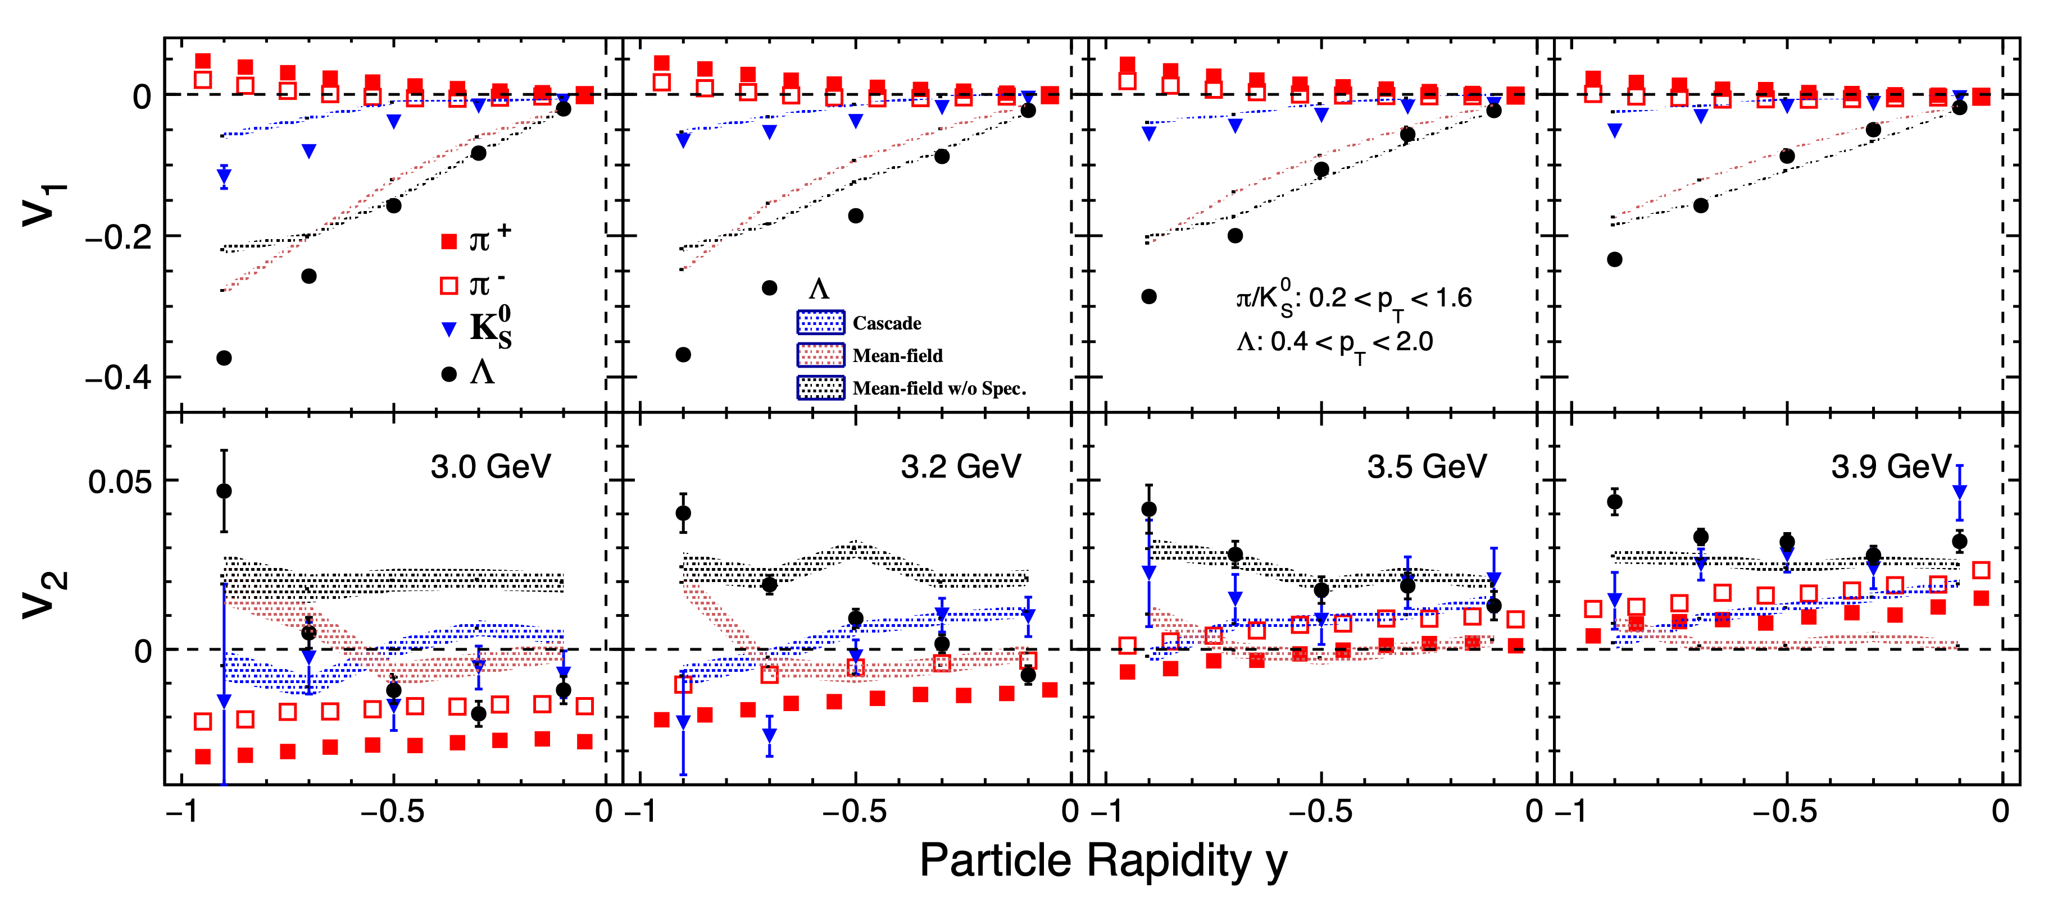
Fig. 2 (v₁/v₂ vs. y)

Slide 6
Fig. 2 (v₁/v₂ vs. y)
Data:
v1: K0s and lambda show positive v1 slope in wide pT window.
v2: Negative v2 gradually becomes positive v2 as collision energy increasing.
Out-of-plane flow → In-plane flow
Model:
v1: v1 slope of K0s becomes larger, in case that the spectator is removed.
v2: If the spectator is not exist, K0s show positive v2 at 3 – 3.9 GeV

Slide 7
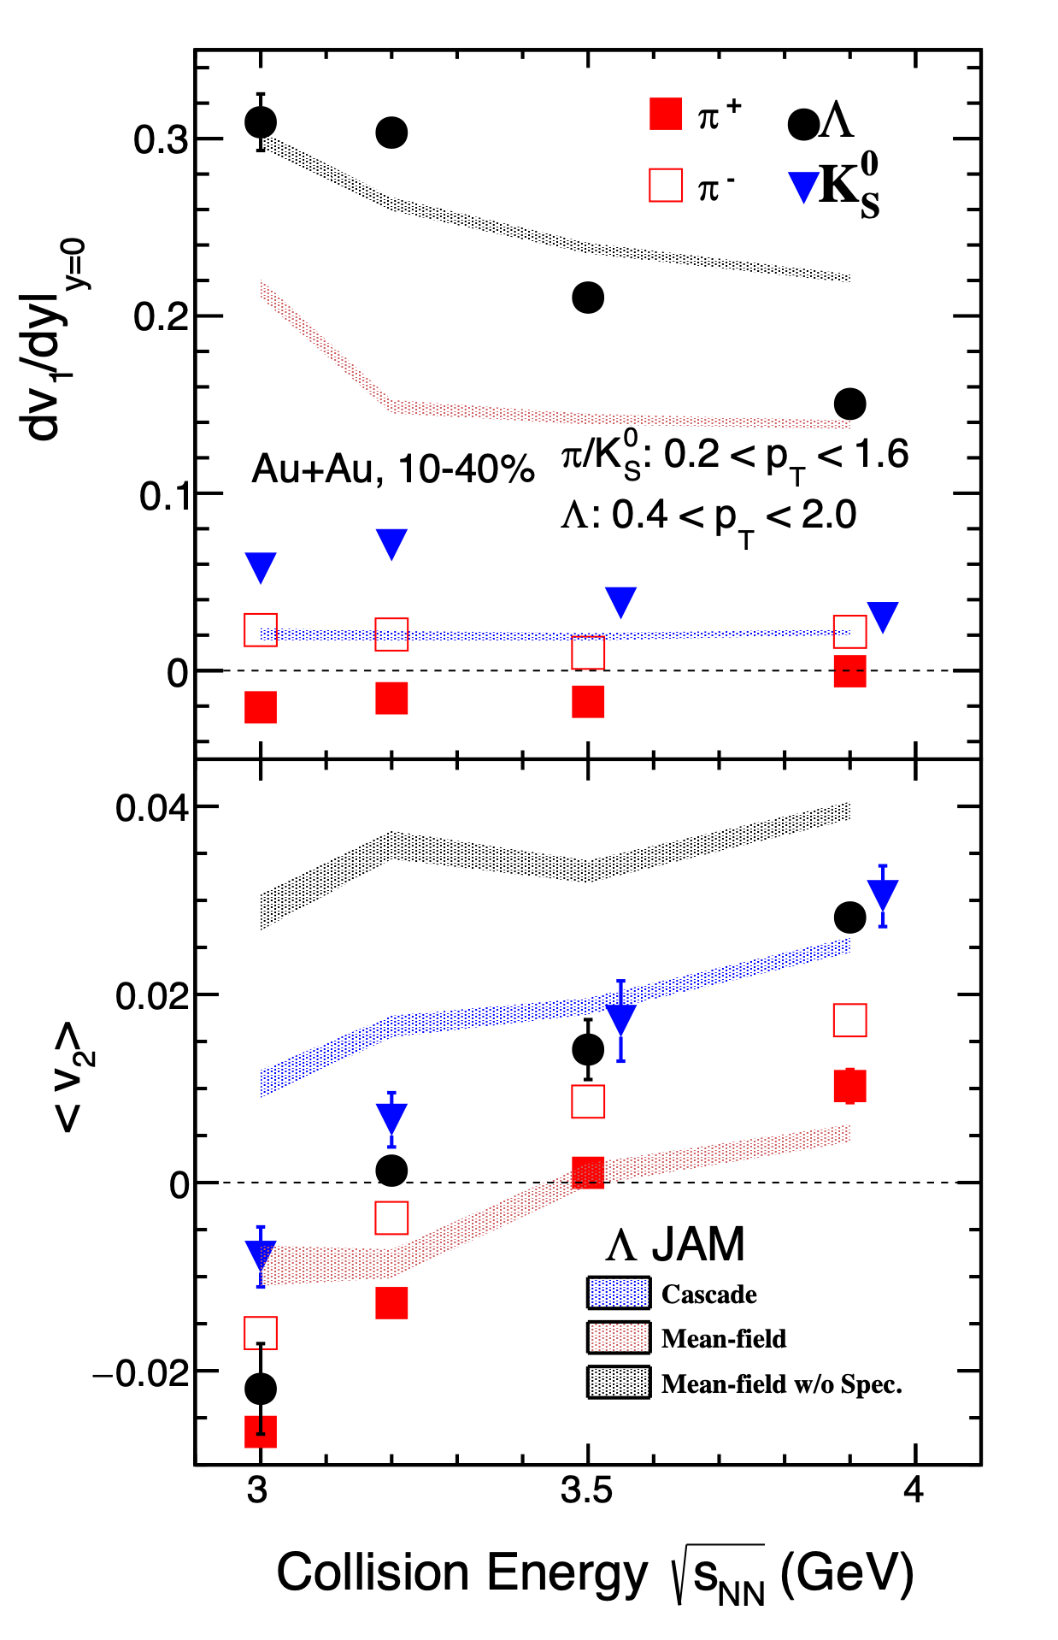
Fig. 3 (v₁/v₂ vs. E)
Data:
v1: v1 slope becomes smaller as the collision energy increasing.
v2: Out-of-plane flow → In-plane flow
Model:
Better description for lambda v1/v2 with baryonic mean-field.

Slide 8
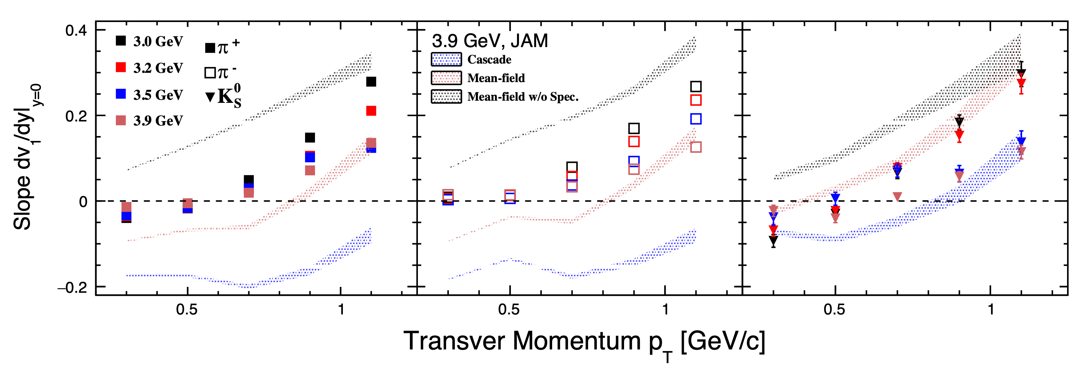
Fig. 4 (dv₁/dy vs. p_{T})
Data:
𝜋+ and K0s show negative v1 slope at low pT. (pT below 0.5 GeV/c or so)
Model:
Anti-flow disappeared at low pT if the spectator is removed.

Slide 9
Backup

Slide 10
Paper proposal
Title: Directed and Elliptic Flow of Light and Strange Hadrons in Au + Au Collisions at $\sqrt{s_{\mathrm{NN}}}$ = 3.0 - 3.9 GeV from the Fixed-Target program at RHIC-STAR
Abstract: Directed and elliptic flow ($v_1$, $v_2$) are the first and second harmonic coefficients in the Fourier expansion of the final state particle azimuthal distribution measured in heavy-ion collisions. They are sensitive to the equation of state (EoS) and degree of freedom of the produced medium. The number of constituent quark (NCQ) scaling of $v_2$ of identified hadrons, indicating the partonic degree of freedom in the medium, is found to hold for collision energies at $\sqrt{s_{NN}}$ = 7.7 GeV and above, but is broken at $\sqrt{s_{NN}}$ = 3.0 GeV. Systematic study of the identified hadron $v_2$ between collision energies of 3.0 and 7.7 GeV will help better understand the nature of the produced medium and its EoS.
With the data from STAR fixed-target program, we will present $v_1$ and $v_2$ results of light and strange hadrons as a function of $p_T$, rapidity, and centrality in Au + Au collisions at $\sqrt{s_{NN}}$ = 3.0, 3.2, 3.5, and 3.9 GeV, corresponding to baryon chemical potential ($\mu_B$) ranges between 630 - 760 MeV. Furthermore, the kaon $v_1$ will be presented as a function of transverse momentum ($p_T$), predicted to be sensitive to kaon mean-field interactions at these energies. The NCQ scaling of $v_2$ will be tested to probe the degree of freedom of the medium. These measurements incorporated with model comparisons will help to infer the QCD phase structure and nuclear matter EoS in the high baryon density region.
Target journal: PRL/PRC
Next few slides show proposed figures for a short PRL paper.

Slide 11
Pion dv1/dy: p_{T} Window Dependence
Fitting function: v1 = p0*y + p1*y^3
Fitting range: -1 < y_CM < 0
Request preliminary

Slide 12
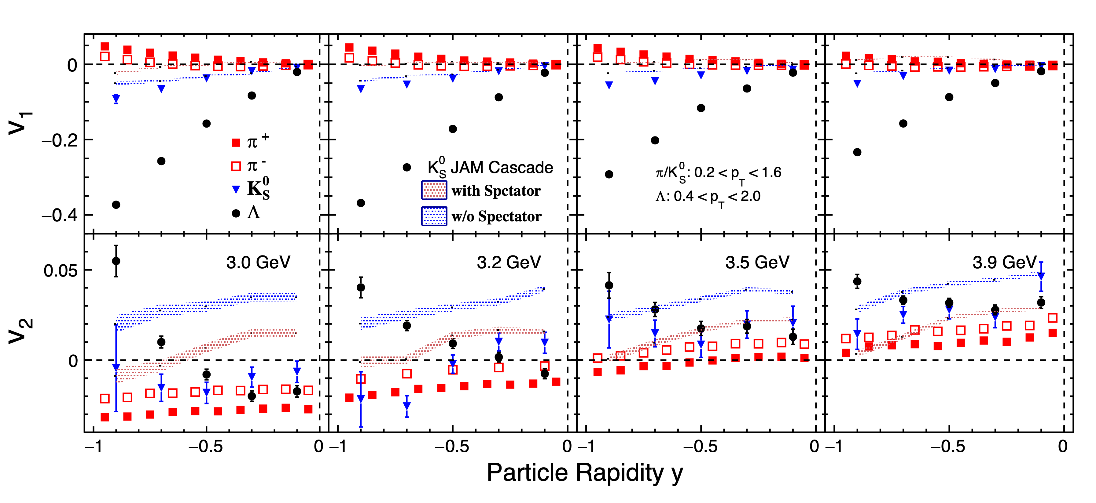
Fig. 2 (v₁/v₂ vs. y)

